Slide 1
Going Global: 7 Information Management Considerations to Keep in Mind
Blanca Chou, Rosalind Young, Lisa Benz
2018 SLA Annual Conference

Slide 2
Agenda
Background
Our Information Landscape: Before 2010 & Current State
Our Global Journey:
Enterprise Literature Ordering and Management System
7 + 1 Considerations
Partnership with Copyright Clearance Center (CCC)
The views and opinions expressed in this presentation are those of the presenters and do not necessarily represent the views of our employers or affiliates.

Slide 3
Otsuka at a Glance
Established 1921
Tokushima, Japan
International network of
183 companies
46,000 employees
45 affiliated research institutes
177 manufacturing sites
Operating in
28 countries and regions
across Asia-Pacific, America, Europe, and the Middle East
Consolidated Net Sales: $11.1 Billion
Notes:
Speak to Slide.
FOR CORPORATE USE ONLY. DO NOT DUPLICATE, DISTRIBUTE, OR USE IN PROMOTION.

Slide 4
Otsuka in North America
PHARMACEUTICALS
NUTRACEUTICALS
CONSUMER
Otsuka America, Inc. (OAI) is a holdings company made up of more than two dozen group companies that offer innovative products in the pharmaceutical, nutraceutical, and consumer markets.
SOFTWARE AND DATA ANALYTICS
COLLABORATIONS
Notes:
Speak to slide.
FOR CORPORATE USE ONLY. DO NOT DUPLICATE, DISTRIBUTE, OR USE IN PROMOTION.
March 2018 01US18EUC0050

Slide 5
Select Consumer Products in North America
Notes:
Speak to slide.
FOR CORPORATE USE ONLY. DO NOT DUPLICATE, DISTRIBUTE, OR USE IN PROMOTION.

Slide 6
Our Information Landscape Before 2010
Limited or Lack of
integrated licenses of copyright and electronic resources globally
global information systems
global information teams and collaboration
Duplicate information cost
Unable to effectively share information globally
Copyright compliance risk

Slide 7
Current State: Global Solutions
Global Information Network (GIN)
34 key pharma affiliates in 18 countries
Info Team: 7 (US) + 15 (Japan) + global affiliate reps
Annual f2f meetings and regular collaboration
Consolidated global licenses for
online resources
Key global information systems
Global user support

Slide 8
Our Global Journey:
Global Information System
7 +1 Considerations

Slide 9
RightFind In Action at Otsuka
34 Otsuka affiliated companies in
18 countries
5 Industries
60,000 articles
in shared
global repository
Pharma
Medical
Devices
Chemical
Nutraceutical
Foods
Notes:
Speak to Slide.
FOR CORPORATE USE ONLY. DO NOT DUPLICATE, DISTRIBUTE, OR USE IN PROMOTION.

Slide 10
1. IT Infrastructure
Assess different technologies and IT infrastructures in different regions
Lack of unified IT environment
Multiple platforms allows greater customization for each affiliate
SAML SSO. Mobile Access.
Different technologies

Slide 11
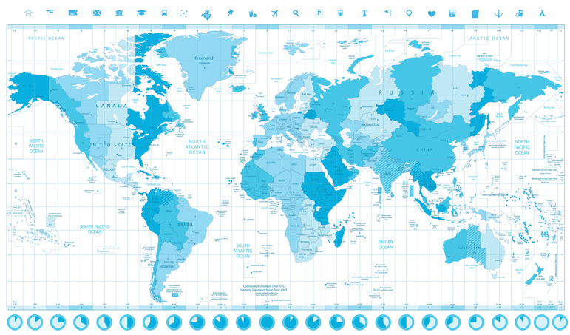
2. Language, Culture & Time Zones
Culture & Working Styles
Understand and respect different cultures
4 Ps: Politeness, Patience, Precise, Punctuality
Build trust and relationships early
Meeting Norms
Communication & Time Zones
Language: users prefer systems in native languages

Slide 12
3. User Adoption Readiness
Develop strategy to target regions & affiliates to adopt and embrace a new system
Demonstrate success
Recruit advocates
Develop relationships and build trust
Local customization is key

Slide 13
4. Regulations
Regulations vary from country to country; each system requires compliance
Discuss requirements ahead; no surprises or delays
Create a checklist of current requirements for each region

Slide 14
5. Business Functions
System needs to be scalable and customizable to accommodate changing business needs
System used by different departments
Develop solutions to support and ensure compliance

Slide 15
6. Systems & Workflows
Human element important to make an information system stick
Understand current workflow for ordering, managing and sharing content in each region
Discover local databases or systems being used and being integrated with the new global system (e.g.: QUOSA, PDQ, Ovid, etc.)

Slide 16
7. Financial Systems
Understand requirements and billing preferences
Billing preferences
Invoices/Chargebacks
Usage Reporting
Notifications to monitor costs

Slide 17
User Support
The most important factor to sustain the success of a globally implemented system
Troubleshooting and Global End User Support
Global End User Training
Global Affiliate Administrator Support
Quarterly Update
Administrator Guide

Slide 18
Partnership with
Copyright Clearance Center

Slide 19
Notes:
CCC, with its subsidiaries RightsDirect and Ixxus, is a global leader in content workflow, document delivery, text and data mining and rights licensing technology for thousands of publishers, businesses and academic institutions.
CCC’s solutions provide anytime, anywhere content access, usage rights and information management while promoting and protecting the interests of copyright holders.
CCC serves more than 35,000 customers and over 12,000 copyright holders worldwide and manages more than 950 million rights from the world’s most sought-after journals, books, blogs, movies and more.

Slide 20
Keys to Successful Global Adoption
Technology
Consultative Collaboration
Communication
Flexibility
Internal Advocacy
Adoption Readiness
Ongoing Support
Notes:
The configurability of RightFind combined with the consultative approach employed by the support team at CCC are important factors in addressing the 7 points described by Rosalind. In my experience, the third element in successful global roll outs is effective advocacy within the organization

Slide 21
Communication and Feedback
360 Review Between Otsuka and CCC
Established Challenges and Successes
Make Adjustments
Identify Strategy
Notes:
Effective Communication and Feedback between vendor and customer
After first phase of the roll out conducted a full 360 review to identify challenges and successes -> developed strategy for streamlined onboarding going forward
Challenges
Accommodate the new Business Functions’ needs without disrupting current user workflows.
Adoption Readiness and buy-in were. - embracing new technologies through a mandate from thousands of miles away can be daunting and frankly, unappealing.
=>difficult to solicit required information from new stakeholders
Successes
creatively develop alternative strategies and platform configurations throughout the implementation

Slide 22
Strategies For Global Roll Out
Identify Appropriate Resources and Support
CCC – Multi-Faceted Support Structure
Otsuka – Identify Internal Stakeholders
Otsuka Adoption Readiness
Socialize Technology
Present Solutions at Outset
Ongoing Support
Notes:
CCC – support team Professional Services Manager, Strategic Client Director, Senior Client Engagement Manager
IRC at Otsuka social - socialize RightFind and the requirements gathering process to the identified stakeholders at each company, and to walk them through the system so that they have a strong understanding of the system before we start implementing. CCC team supports in this effort.
As we continue to add new groups both IRC and CCC can quickly identify where complexities could like and address them up front, so that there are few surprises. Stakeholders are presented with the best solutions at the outset
Ongoing Support from IRC and CCC team

Slide 23
International Support
Utilize Key Partnerships
Flexibility
Work to Understand Cultural Nuances
Utilize Client Expertise
Notes:
The support model that we established with Blanca was been extended to implementing the international business units at Otsuka. To handle the nuances of culture, word choice and time zones we work with partners in Japan for language support, with whom we have regular meetings outside of US business hours in order to accommodate time zones. For those times that we work directly international contacts at Otsuka, the CCC team studied and researched the cultural business practices of each area, and we also rely on Blanca’s expertise and knowledge of the organization and varied geography in which it operates.

Slide 24
Takeaways

Slide 25
Takeaways
Effective communication are keys to building trust, relationships, and partnerships with global affiliates and the vendor
Look beyond technology and not just implementation; focus on human factors and system adoption and use
User support is necessary to communicate value of system, enhance user experience, and help resolve challenges for global affiliates

